Slide 1
L3 Data Transmission
Chapter 3
Data Transmission : Stallings W., Data & Computer Communications (9e), Pearson Education Inc., Noida, 2017.

Slide 2
Periodic Signal
The simplest sort of signal is a periodic signal, in which the same signal pattern repeats over time.
Mathematically, a signal s(t) is defined to be periodic if and only if
where the constant T is the period of the signal. Otherwise, a signal is aperiodic.

Slide 3
Periodic analog signal
Periodic analog signal characterized by 3 parameters.[Amplitude :A, Frequency: f and Phase φ]
Representation of sine wave
s (t) = A sin (2πft + φ)
Where A is peak amplitude.
2π radians = 360° = 1 period
.

Slide 4

the frequency components of the square wave with amplitudes A and –A can be expressed as follows: [using Fourier Series]

Slide 5
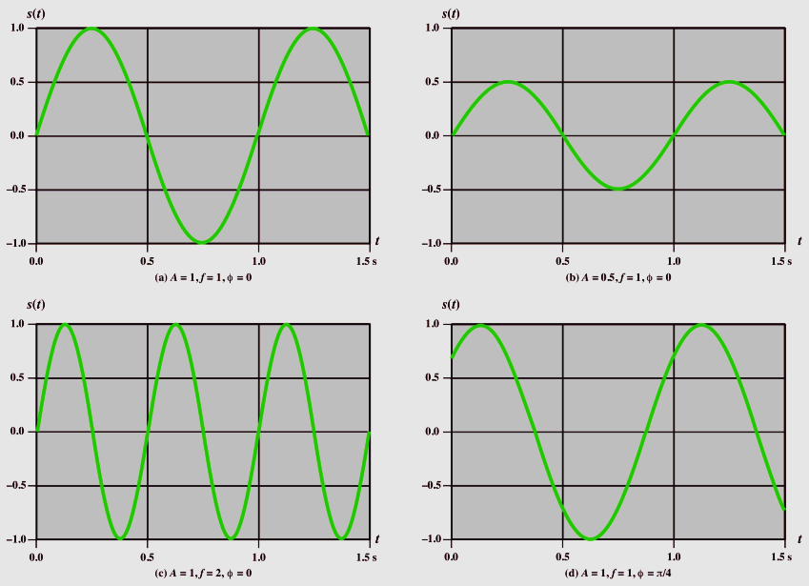
.

Slide 6
UNITS of Parameter
Amplitude : volts, milli (10⁻³) volt, KV(10³)
Frequency : Hz, KHz(10³), MHz(10⁶), GHz(10⁹), THz(10¹²)
Time : second, milli second(10⁻³), micro second(10⁻⁶), ns(10⁻⁹), ps(10⁻¹²)
Phase : degree , radian
.

Slide 7
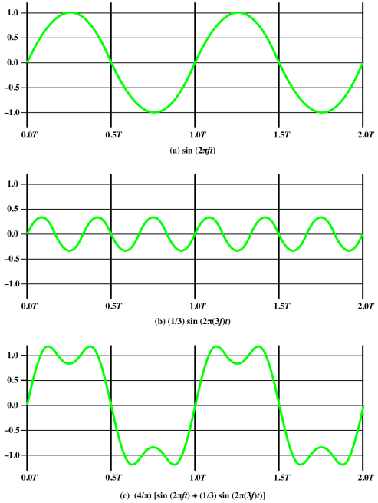
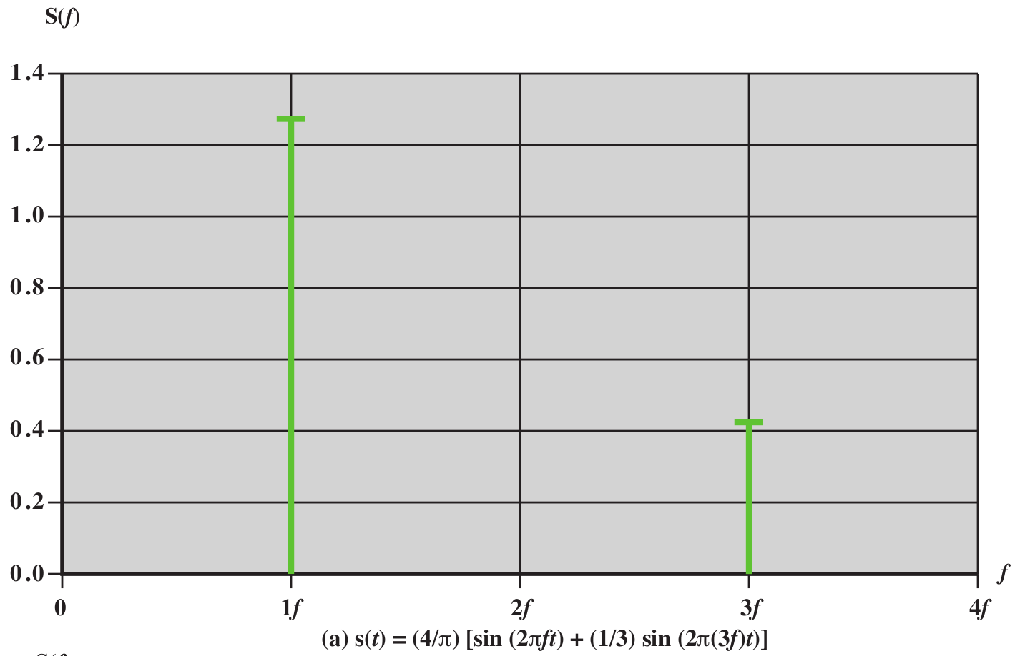
.

Slide 8
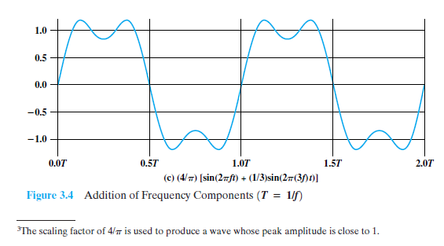
Frequency Domain Concepts
The spectrum of a signal is the range of frequencies that it contains. For the signal of Figure 3.4c, the spectrum extends from f to 3f.
.

Slide 9
Frequency Domain Concepts
The absolute bandwidth of a signal is the width of the spectrum. In the case of Figure 3.4c, the bandwidth is 2f.
most of the energy in the signal is contained in a relatively narrow band of frequencies. This band is referred to as the effective bandwidth, or just bandwidth.
.

Slide 10
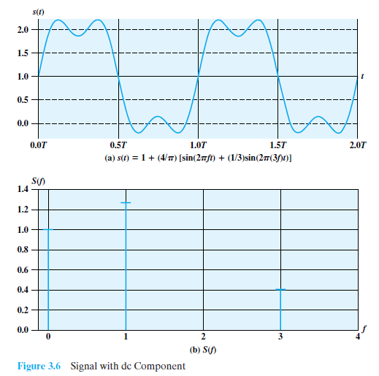
dc component:-
If a signal includes a component of zero frequency, that component is a direct current (dc) or constant component.
For example, Figure 3.6 shows the result of adding a dc component to the signal.
No DC component if average amplitude = 0

Slide 11
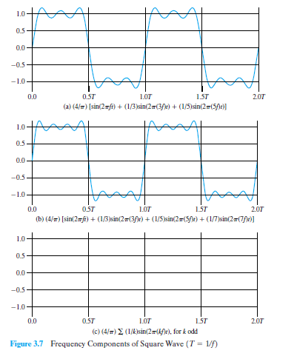
By adding together sine waves at frequencies f and 3f, we get a waveform that begins to resemble the original square wave.
adding a sine wave of frequency 5f, as shown in Figure 3.7a,
and then adding a sine wave of frequency 7f, as shown in Figure 3.7b.
As we add additional odd multiples of f, suitably scaled, the resulting waveform approaches that of a square wave more and more closely.

Slide 12
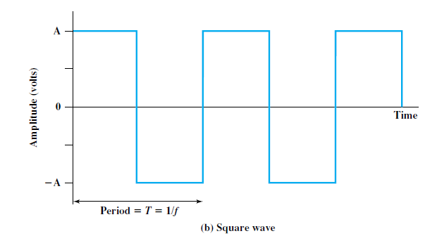
Relationship between Data Rate and Bandwidth
consider the square wave.
let positive pulse represent binary 0 negative pulse represent binary 1.
Then the waveform represents the binary stream 0101. . . .
The duration of each pulse is T/2 = 1/(2f )
thus the data rate is 2f bits per second (bps).
.

Slide 13
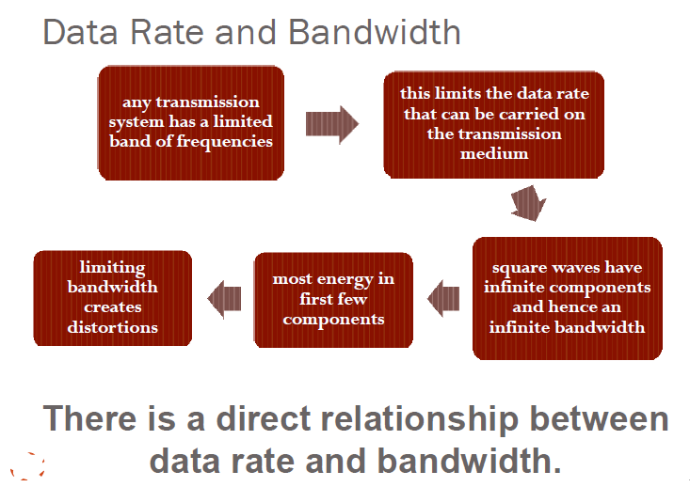

Slide 14
Relationship between Data Rate and Bandwidth
Waveform has an infinite number of frequency components and hence an infinite bandwidth.
What happens if we limit the bandwidth to just the first three frequency components?
Suppose a digital transmission system is capable of transmitting signals with a bandwidth of 4 MHz.
What data rate can be achieved? We look at 3 cases.
.

Slide 15
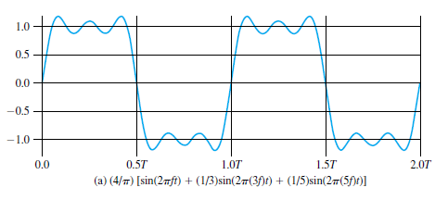
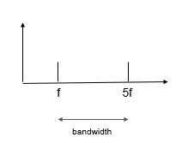
What data rate can be achieved? We look at three cases.
Case 1:
Let f be 1MHz
Bandwidth = (5x10^6)-(1x10^6) = 4MHz
T=1/f=1/(10^6)=1x(10^-6)s=1μsecs
Bit interval = 0.5T=0.5 μ secs
data rate=1/(Bit interval)=1/0.5μ secs = 2Mbps

Slide 16
What data rate can be achieved? We look at three cases.
Case 2:
Let f be 2MHz
Bandwidth = (5x2x10^6)-(2x10^6) = 8MHz
T=1/f=1/(2x10^6)=1x(2x10^-6)s=0.5μsecs
Bit interval = 0.5T=0.5*(0.5 μ secs)=0.25 μsecs
data rate=1/(Bit interval)=1/0.25μ secs = 4Mbps

Slide 17
What data rate can be achieved? We look at three cases.
Case 3:
Let frequency(f) be 2MHz
Bandwidth = (3x2x10^6)-(2x10^6) = 4MHz
Period(T)=1/f=1/(2x10^6)=1x(2x10^-6)s=0.5μsecs
Bit interval = 0.5T=0.5*(0.5 μ secs)=0.25 μsecs
data rate=1/(Bit interval)=1/(0.25μ secs) = 4Mbps

Slide 18
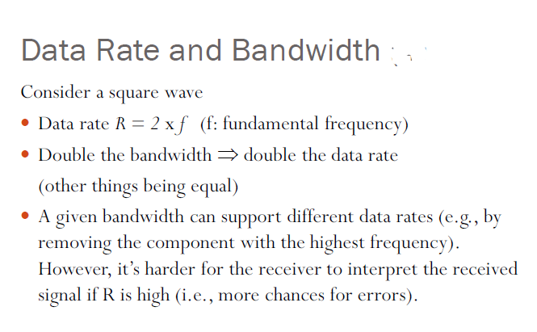

Slide 19
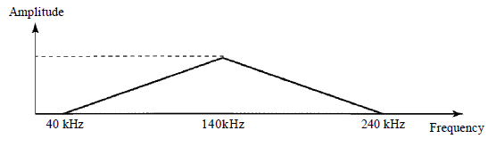
Bandwidth
A nonperiodic composite signal has a bandwidth of 200 kHz, with a middle frequency of140 kHz and peak amplitude of 20 V.
The two extreme frequencies have an amplitude of 0.
Draw the frequency domain of the signal..
Solution
.

Slide 20
wavelength
Distance occupied in space by a single period.
Wavelength = propagation speed / frequency.
Example : wavelength of redlight (frequency = 4*10¹⁴ Hz) is
c/f = 3*10⁸m/s /4*10¹⁴
^{= 0.75 micro meter}
.

